Slide 1
CADx in Lung Cancer
Md. Kamrul Hasan, Basel Alyafi
Notes:
In this lecture, we are going to talk about Computer Aided Diagnosis in Lung cancer. We are going to focus on one paper and results they got in classifying lung nodules.

Slide 2
Outline
Introduction
Recent work
A technical Flash
Restricted Boltzmann Machines
Deep Belief Network
Results
Conclusion
Notes:
In the introduction, two main points are discussed, medical introduction and technical introduction. In the medical introduction, we are going to talk about lung cancer causes and complications. While, in the technical introduction, we are going to define lung nodules with pictorial examples in addition to dividing classifying methods into two major types (pipelines and machine learning).
After that, a brief overview of what has already been done in this field (3 main papers are discussed briefly and one in some details). Then, a technical flash on Hua et al paper is given in order to show why we are going to talk about Restricted Boltzmann Machines (RBM) and Deep Belief Networks (DBN).
Then it comes to RBMs architecture and properties, who invented RBMs and when.
In the second part of this presentation, DBNs are discussed, in terms of design, benefits over traditional machine learning and neural networks.
Results are given thereafter to show what Hua et al got from their system and to compare it to handcrafted features.
Last but not least, a conclusion and future work is given.

Slide 3


Medical Introduction
The leading cause of cancer deaths worldwide!
Only Smokers? No
Causes:
Secondhanded smoke
Genes history
Radon gas
Metastases
Complications:
Bloody coughs
Pain (chest, bones)
Shortness of breath
Notes:
Lung cancer is the uncontrolled growth of lung cells which usually have the following properties [2]:
the born cells do not replicate the parent’s DNA.
they do not behave in a similar manner to a normal lung cell; do not produces oxygen and absorbs carbon dioxide.
The reason beyond its life-threatening danger is that it has no/poor prognosis, either you detect the disease early or death highly probably will the result. It has been the deadliest in men and women even more than breast, prostate, ovarian, and colon cancers COMBINED [1].
Risk factors:
Smoking: the more cigarettes a person smoke, the more endangered this person is.
Secondhand smoke, even if the person does not smoke, breathing the smoke might cause lung cancer.
Cancer in other parts of the body: cancerous cells can travel in a shape of metastases and stay in other parts of the body
Family history: if the family has a history with cancer, cancer might have higher probabilities than other people coming from no-cancer families.
Complications:
Coughing with blood, even in small amounts, might be an alarm.
Pain: when cancerous lung cells travel to bones, it may cause pain, especially in chest cage.
Metastasis: when cancer starts moving in the body, it becomes uncurable.
References:
[1] “Lung Cancer”, by Mayo Clinic Staff, retrieved from https://www.mayoclinic.org/diseases-conditions/lung-cancer/symptoms-causes/syc-20374620, visited on 16-Dec-2018 16:40.
[2] “Lung Cancer 101”, retrieved from https://www.lungcancer.org/find_information/publications/163-lung_cancer_101/265-what_is_lung_cancer, visited on 16-Dec-2018 17:04.

Slide 4
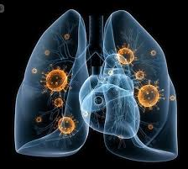
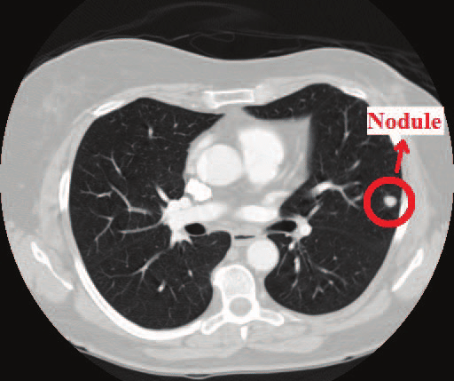
Technical Intro
Nodules
What if surface diameter >=30 mm?.
Evolvement.
Shape/view
Classification
Ad-hoc
End-to-end
Notes:
Lung Nodules:
Lung nodules are usual round white shadows that appear in an X-ray/CT scans even in healthy patients. Their sizes range from a few millimeters to a few tens of millimeters. Doctors give more care to nodules with larger sizes (around 30 mm) because it has some cancer implications [1].
Not only size matters, but also the temporal evolvement bear some information. If a nodule did not exist in a previous scan, but now it does, it might be malignant. Additionally, the more random the shape of the nodule, the more probable it is cancerous. So, looking at nodules from different points of view is important to detect the abnormality.
Classification:
Two main approaches are common in the field of image processing in general:
Pipelines: a sequence (with/without feedbacks) of image processing blocks with single/multi channel/s..
End-to-end: in which a black box (a neural network for instance) has an input of raw (or preprocessed) data and an output of information.
Both approaches can be applied in the application of lung nodules classification, where for the first approach, the chain of image processing blocks is used to craft manually some features which will be clustered by the means of, for example, K nearest neighbors (KNN) at the end of the chain. On the other hand, End-to-end approaches are capable of learning the features automatically from the input image and then deciding whether the input sample is benign or not.
The pros of the first approach include that it does not need massive amounts of training images. While, cons include that usually the process of selecting and integrating the features does not guarantee the satisfying functionality of the whole sequence. Additionally, a failure in one block of the chain will cause a disastrous effect on the final result.
On the other hand, the advantages of using the second approach are that features are learned and integrated in a way useful for the application. The major minus of this approach, currently, is the giant training database it needs to learn patterns.
References:
[1]- “Lung nodules: Can they be cancerous?”, by Eric J. Olson, M.D., retrieved from https://www.mayoclinic.org/diseases-conditions/lung-cancer/expert-answers/lung-nodules/faq-20058445, visited on 16-Dec 2018 at 18:37.

Slide 5
Outline
Introduction
Work done on Classification (benign/malignant)
A technical Flash
Restricted Boltzman Machines
Deep Belief Network
Results
Conclusion

Slide 6
Some recent work
[2018] Tajwar A., Multi-View Multi-Time Point CNN.
[2018] Wenqing Suna et al, CNN + DBN, LIDC.
[2016] Gijs van T., Marleen de B., Combining Generative and Discriminative Representation with RBM, ieee TMI
[2015] Hua et al, CNN + DBN, Lung image Database Consortium (132 citations!).
Notes:
In the first paper [1], Tajwar A. analyzed the importance of looking at lung nodules from different points of view (different planes include axial, sagittal and coronal and corresponding 6 diagonal planes taken by moving one side a time of the three main planes (sagittal, axial, and coronal) to the opposing end of the cube) and at different temporal points. He found out that considering the growth improved the results by around 5%.
In the second paper [2], authors used three different mechanisms to classify lung nodules, namely: Convolutional Neural Networks or CNN, Deep Belief Networks (DBN), and Stacked Denoising Autoencoders (SDAE). They concluded that DBN proved performing better than other two methods.
In the third paper [3], authors relied on the idea that RBMs usually are trained first unsupervisedly to represent the data (learn variations), then the RBM is trained supervisedly to classify nodules (discriminative learning objective). Authors said that sometimes within-class variations (inter-patient variations for example) are larger than inter-class variations which will mislead the networks to learn the former variations instead of the latter. So to overcome that issue, they proposed a weighted average of both learning objectives, so the network can learn more useful features for classification.
Hua et al paper [4], the forth one, is the main topic for this presentation, where they compared old-fashion feature carving using Scale Invariant Feature Transform (SIFT) and Local Binary Patterns (LBP) and found out that End-to-end systems defeated traditional ways of doing the classifications.
References:
[1] Tajwar A., “Malignancy estimation of Pulmonary Nodules using Multi-View Multi-Time Point Convolutional Neural Networks”
[2] Wenqing S., Bin Z., Wei Q., “Computer aided lung cancer diagnosis with deep learning algorithms”
[3] Gijs van T., Marleen de B., “Combining Generative and Discriminative Representation Learning for Lung CT Analysis with Convolutional Restricted Boltzmann Machines”.
[4] Kai-Lung H., Che-Hao H., Shintami Chusnul H., Wen-Huang C., Yu-Jen C., “Computer-aided classification of lung nodules on computed tomography mages via deep learning technique”

Slide 7
Outline
Introduction
Work done on Classification (benign/malignant)
A technical Flash
Restricted Boltzmann Machines
Deep Belief Network
Results
Conclusion
Notes:
References:
[1]: Kai-Lung H., Che-Hao H., Shintami C. H., Wen-Huang C., Yu-Jen C., Computer-aided classification of lung nodules on computed tomography images via deep learning technique.

Slide 8
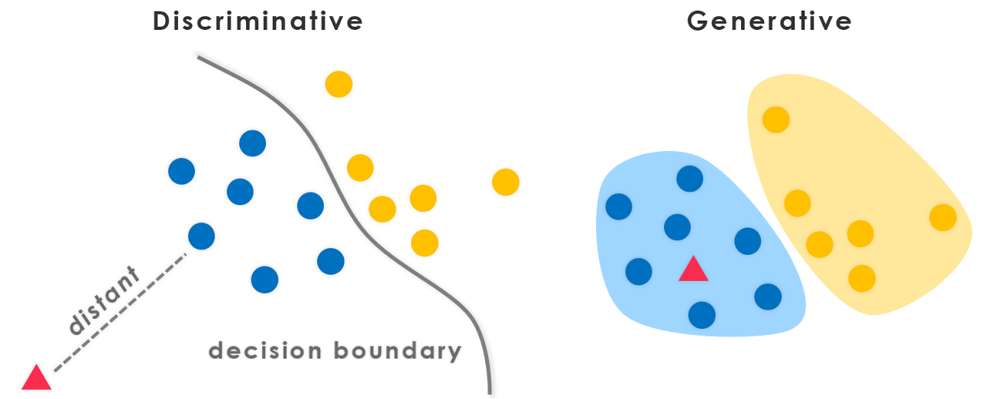
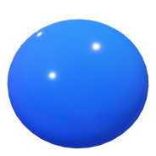
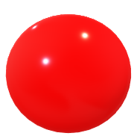
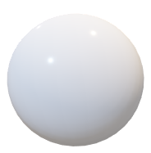
Technical Flash
Data collection with multiple annotation sources
Intersection
Union
all
Data representation
Hand-crafted features
Learned features
Learning objective
Generative (representation)
Discriminative (classification)
Both!
Notes:
A general technical flash here is given to refresh/inspire some ideas. First suppose we have an unannotated lung nodules dataset that we have given to N radiologists. After we get the results, annotations are mostly non-identical but differ is sizes, boundaries. To overcome this issue, researcher tend to follow different aspects:
take only the intersection. In this case you are sure that the nodule is precisely annotated ( radiologists agreed on it).
take the union of all the annotations. In this case, you will keep all the information given by specialists.
take the annotations individually, means, each radiologist’s output is considered a separate case.
The last option is the most promising one owing to the following facts, for the first option, the intersection is not guaranteed to have complete information about the nodule. For the second option, it will overcome the first option’s problem but it will not provide data augmentation. The third option doe not miss any information and augment the dataset by a factor of N.
Data representation:
To represent data, in other words, to give a feature vector that carries important properties of the input, different ways are taken.
image processing pipelines, like SIFT, SURF, HOG, and others which are tedious and time-consuming. The way features are selected, tuned, and integrated does not guarantee the optimum performance of the system for the purpose of classification.
learned features are automatically crafted and integrated by machine learning techniques by using backpropagation algorithm to have a minimum cost function.
Learning Objective:
In Generative learning, the goal is to learn patters, i.e., tendencies of features. For a feature x, each class has a distribution that might intersect with other class(es) distribution(s). While for discriminative learning, the goal is to put a threshold between each pair of classes to classify data. By using Bayesian models, it is possible to get the posterior probability from the generative (likelihood probability). Usually, generative models learn variations regardless of the class of the sample. In this case, if large variations tend to happen inside the one class, generative models will be less useful for the classification purpose.
Both of models can be used as a weighted average to train a machine learning system as the authers of [1] did.
Keywords: within-class variations, inter-patient variations, inter-disease variations.
References:
[1]: Gijs van T.; Marleen de B., Combining Generative and Discriminative Representation Learning for Lung CT Analysis With Convolutional Restricted Boltzmann Machines, ieee Transactions on Medical Imaging Feb. 2016, pages 1262 1272.

Slide 9
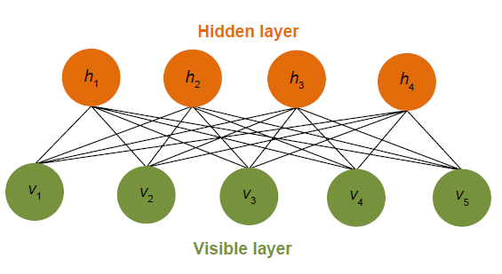
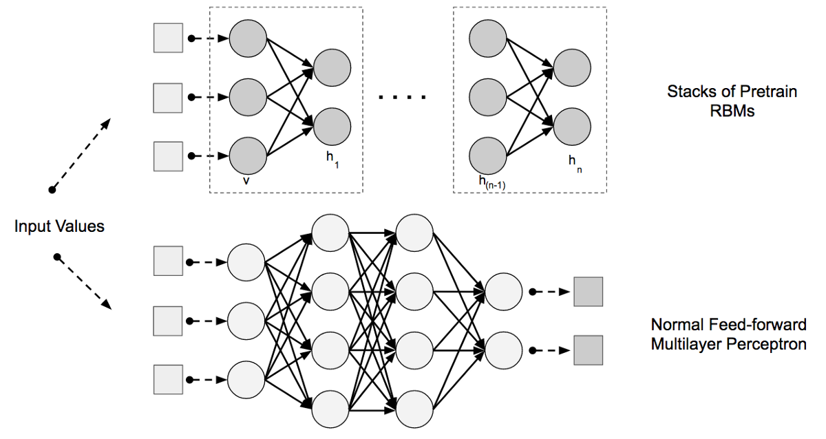
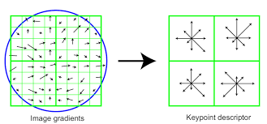
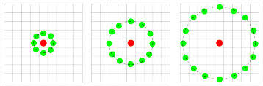


Technical Flash on Hua et al
Stack of RBMs
…..
Stack of RBMs
End-to-end
32
32
CNN
SIFT
Hand-crafted features
KNN
LBP
Notes:
In Hua et al [1], they had two main approaches to classify lung nodules:
end-to-end approach, where they used DBN as well as CNN. The input is a nodule path of size 32 by 32 pixels.
handcrafted features (SIFT integrated with LBP) with K-nearest neighbours to cluster data.
At the end, the found out that DBN was performing better than CNN and hand crafted features with higher specificity.
References:
[1]: Kai-Lung H., Che-Hao H., Shintami C. H., Wen-Huang C., Yu-Jen C., Computer-aided classification of lung nodules on computed tomography images via deep learning technique

Slide 10
Outline
Introduction
Work done on Classification (benign/malignant)
A technical Flash
Restricted Boltzmann Machines
Deep Belief Network
Results
Conclusion
Notes:
References:
[1]: Kai-Lung H., Che-Hao H., Shintami C. H., Wen-Huang C., Yu-Jen C., Computer-aided classification of lung nodules on computed tomography images via deep learning technique.

Slide 11
Restricted Boltzmann Machines
Geoff Hinton et al, Univ. of Toronto 1985, 2006.
Boltzmann?
Undirected
No connections among hidden units
Notes:
In 1985, Geoffrey Hinton et al invented the Restricted Boltzmann Machines. It had the name of the Mechanical engineer Boltzmann because they used an energy function similar to the one Boltzmann used to train the network.
An RBM has the following properties:
each RBM has a visible layer and a hidden layer.
nodes in the hidden layer are disconnected, so conditionally independent.
it is undirected generative graph, in which weights from visible layer to hidden layer are the same both ways.
References:
[1]: David H. Ackley, Geoffrey Hinton, Terrence J. Sejnowski, A learning algorithm for Boltzmann machines, 1985
[2]: Ruslan S., Andriy M, Geoffrey H., Restricted Boltzmann Machines for Collaborative Filtering, 2006
[3]: Kai-Lung H., Che-Hao H., Shintami C. H., Wen-Huang C., Yu-Jen C., Computer-aided classification of lung nodules on computed tomography images via deep learning technique
RBM figure was taken from [3] paper.

Slide 12
Outline
Introduction
Work done on Classification (benign/malignant)
A Technical Flash
Restricted Boltzmann Machines
Deep Belief Network
Results
Conclusion
Notes:
References:
[1]: Kai-Lung H., Che-Hao H., Shintami C. H., Wen-Huang C., Yu-Jen C., Computer-aided classification of lung nodules on computed tomography images via deep learning technique.

Slide 13
Deep Belief Network (DBN)
Why Deep Belief Network (DBN)?

Slide 14
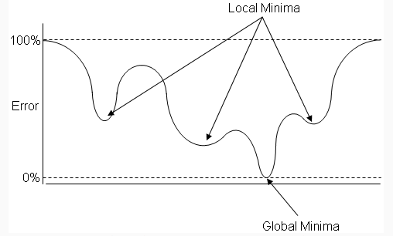
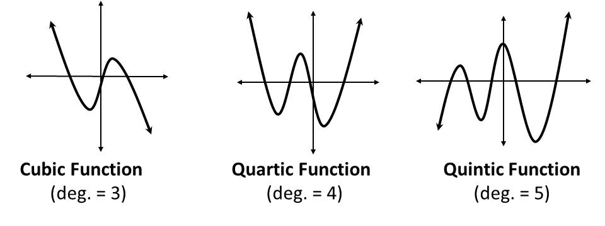
Limitations of traditional MLP/ ANN
Backpropagation
Local minima.
Multiple grooves.
Notes:
One problem with traditional multilayer perceptron (MLP) / artificial neural networks (ANN) is that backpropagation can often lead to “local minima”. This is when “error surface” contains multiple grooves and gradient descent falls into a local groove which is not the lowest possible groove.
Whenever there are more layers in the network, there are more degrees of freedom in the weight matrix. The more the degrees of freedom, the more the possibility of trapping in local minima during the performing the gradient decent. In the Figure, it is shown that when degree of freedom is increasing, the grooves are also increasing.
References:
Polynomials figure was taken from http://muthu.co/simple-example-of-polynomial-regression-using-python on 16-Dec 2018.
Error figure was taken from : https://lazyprogrammer.me/deep-learning-tutorial-part-33-deep-belief/

Slide 15
Deep Belief Network (DBN)
How does DBN solve the problems in MLP/ ANN?

Slide 16
What is DBN?
Notes:
In machine learning, a deep belief network (DBN) is a generative graphical model, or alternatively a class of deep neural network, composed of multiple layers of latent variables, with connections between the layers but not between units within each layer.
DBNs are composed of layers of Restricted Boltzmann Machines (RBMs) which is stacks of pretrain RBMs for the pre-train phase and then a feed-forward network for the fine-tune phase.
References:
Image Source: codeburst.io/deep-learning-deep-belief-network-fundamentals-d0dcfd80d7d4, retrieved on16 Dec-2018

Slide 17
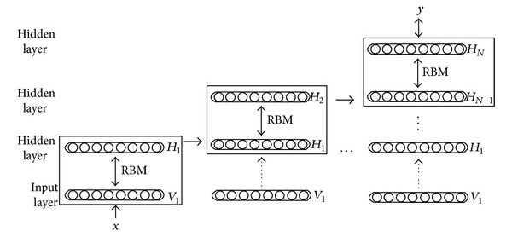
How does DBN work?
1. Learn features from the visible units.
2. Learn features of features in a second hidden layer.
3. Continue up to last hidden layer.
Notes:
DBN is multi-layer belief networks where each layer is Restricted Boltzmann Machine (RBM) stacked to form the Deep belief Network. The first step of training DBN is done unsupervisedly to learn a layer of features from the visible units using Contrastive Divergence (CD) algorithm. Then, the next step is to treat the activations of previously trained features as visible unites and learn features of features in a second hidden layer. The previous process is repeated until the last RBM (with the last hidden layer). Finally, the whole DBN is trained supervisedly when the learning for the final hidden layer has been achieved.
Training of the DBN has been performed in two ways-
Unsupervised learning
Supervised learning
In the unsupervised learning, each RBM has been trained to get the knowledge from the Data/ Images.
In the supervised learning, all the pre-trained RBMs are trained with the gradient decent to get final weight matrix for the future classification.
References:
Image was taken from https://www.researchgate.net/publication/263397266_A_Vehicle_Detection_Algorithm_Based_on_Deep_Belief_Network/figures?lo=1

Slide 18
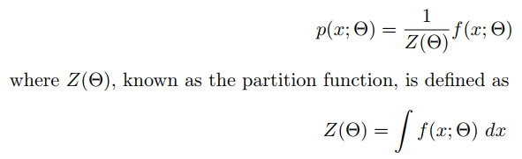

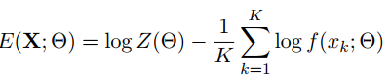
Contrastive Divergence (CD)
The probability of x, p(x; Θ) must integrate to 1 over all x, therefore, we get
Model parameters, Θ can be learnt by minimizing the negative log of p(X; Θ), denoted E(X; Θ)
Notes:
Contrastive divergence (CD) is highly non-trivial compared to an algorithm like gradient descent, which involved just taking the derivative of the objective function. CD is an approximate Maximum-Likelihood (ML) learning algorithm proposed by Geoffrey Hinton.
Partition function is a special case of a normalizing constant in probability theory which is used to reduce any probability function to a probability density function with total probability of one.
First, let us choose our probability model function, f(x; Θ), to be the pdf of a normal distribution, N(x; µ, σ), so that Θ = {µ, σ}. The integral of the pdf is 1 (a standard result, though the proof is not trivial), so that log Z(Θ) = 0. Differentiating Equation 4 with respect to µ shows that the optimal µ is the mean of the training data, X, and a similar calculation with respect to σ shows that the optimal σ is the square root of the variance of the training data.
References:
Notes were taken from : http://www.robots.ox.ac.uk/~ojw/files/NotesOnCD.pdf

Slide 19
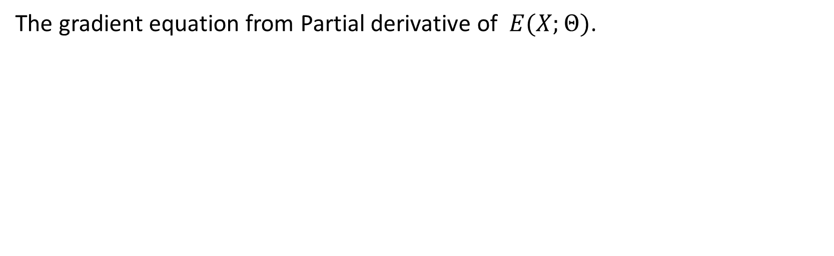
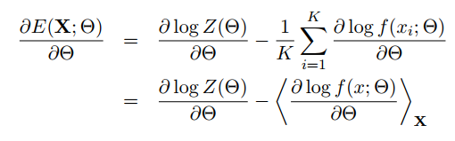
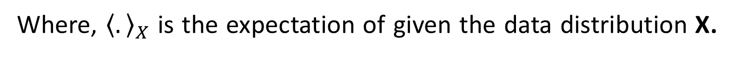

Contrastive Divergence (CD) (Cont^{d})
Parameters update equation
Notes:
CD estimates energy function’s gradient for a set of model parameters, Θ, and training data, X.
Parameters are updated using the gradient ascent equation. where η is the step size factor, which should be chosen experimentally, based on convergence time and stability .

Slide 20
How Does DBN solve ANN problems?
By using an extra step called “pre-training”.
Pre-training is done before backpropagation and can lead to an error rate not far from optimal.
Starting from the “neighborhood” of the final solution.
Backpropagation slowly reduces the error rate.
Notes:
Strictly speaking, multiple layers of RBMs would create a deep belief network – this is an unsupervised model. A supervised model with a softmax output would be called a deep neural network. Deep belief networks solve the problems of traditional MLP/ ANN by using an extra step called “pre-training”. Pre-training is done before backpropagation which leads to an error rate not far from optimal solution. There is a lower probability of being trapped in local grooves. Thus, in DBN, optimizer starts from the “neighborhood” of the final solution (global minima/ groove). Then we use backpropagation to slowly reduce the error rate from there. It can roughly be resembled to training a neural network layer by layer which will reduce the probability of overfitting (less parameters to learn) by dividing the big task to smaller subtasks.

Slide 21
Outline
Introduction
Work done on Classification (benign/malignant)
A Technical Flash
Restricted Boltzmann Machines
Deep Belief Network
Results
Conclusion
Notes:
References:
[1]: Kai-Lung H., Che-Hao H., Shintami C. H., Wen-Huang C., Yu-Jen C., Computer-aided classification of lung nodules on computed tomography images via deep learning technique.

Slide 22

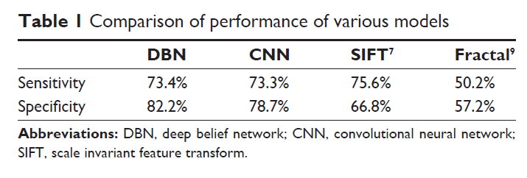
Results
DBN
CNN
LBP+SIFT
Spec 82
Spec 78
Spec 66
Notes:
In the paper mentioned, authors found out that DBN outperformed other methods in general (highest specificity) while sensitivities were almost similar as shown in the table above. This result shows that DBN might have a bright future in the field of classification which will reduce the usability of SIFT and other engineered features in the future.
References:
table it was taken from Hua et al paper.

Slide 23
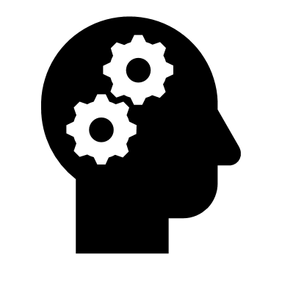
Conclusion
Future of DBN?
Data size DBN V.S. CNN?
Good bye SIFT ?
Input rescaling -> a cue lost?
Notes:
As has been seen, DBN performed quite well on lung nodules classification compared to CNN and handcrafted features. Applications of DBN are countless and can be used for different image processing problems. One of the main ideas of DBN is that learning features layer by layer will lessen the need to massive amounts of input data (lesser parameters to tune need lesser data) which is considered a real problem in medical imaging applications where annotated data is invaluable and hard to get. On the contrary, CNN still need mountains of data to train a deep network to a complicated task. SIFT and other members of the family of handcrafted features seem to be less used while the machine learning is improving and giving better features with lesser efforts.
One important point was mentioned at the end of Hua et al paper was that a cue was lost when rescaling the input patch to a predefined dimension (32 by 32). This cue is essential in some case where nodule shape matters. It is wise to think about networks that accept any dimensions on the input to overcome the limitation of input size of current systems.

Slide 24

Thank you

